Slide 1
Sales Analysis Dashboard
Problem Statements, Objectives, Insights, and Recommendations
Created using Tableau

Slide 2
Introduction
This presentation provides a summary of analytical insights generated from the Superstore dataset using Tableau. Each slide highlights a specific problem area along with its objective, key insights, and actionable recommendations.

Slide 3
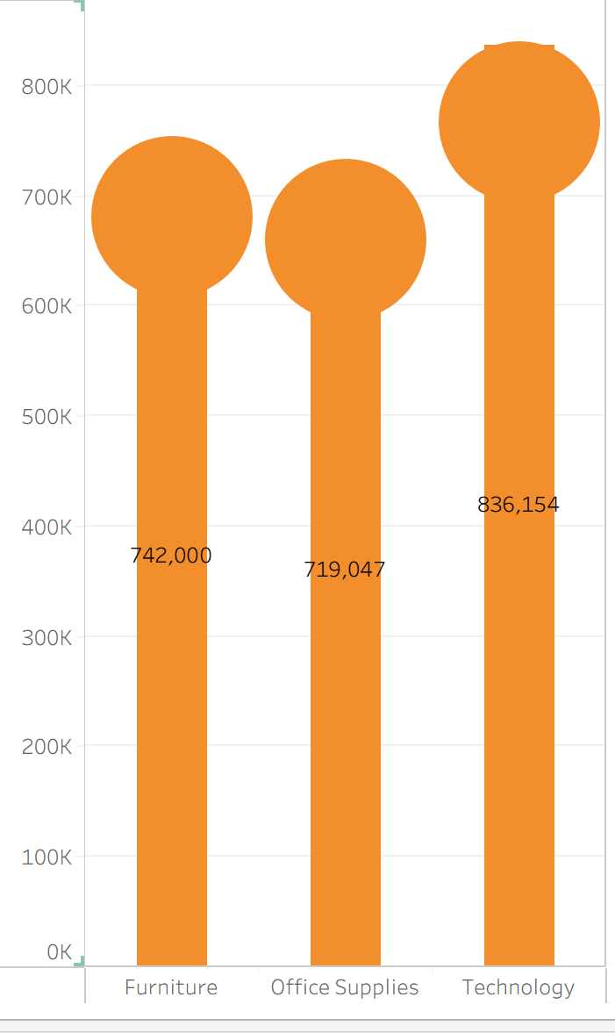
Category-wise Sales
Problem Statement:
The company needs to identify which product
categories generate the most sales to improve strategy.
Insights:
Technology leads; Office Supplies lags.
Recommendations:
Boost office supplies sales through marketing.

Slide 4
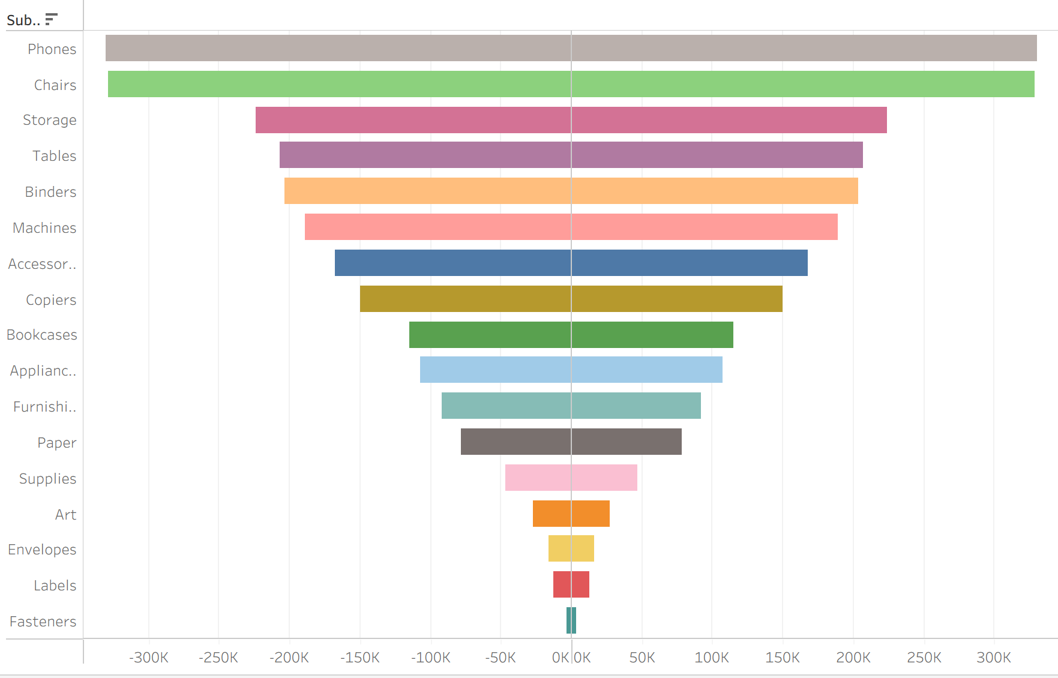
Sub-Category-wise Sales
Problem Statement:
Management wants to find top and low-selling sub-categories to guide inventory decisions.
Insights:
Phones and Chairs
perform best.
Recommendations:
Focus on top performers; reevaluate weak ones.

Slide 5
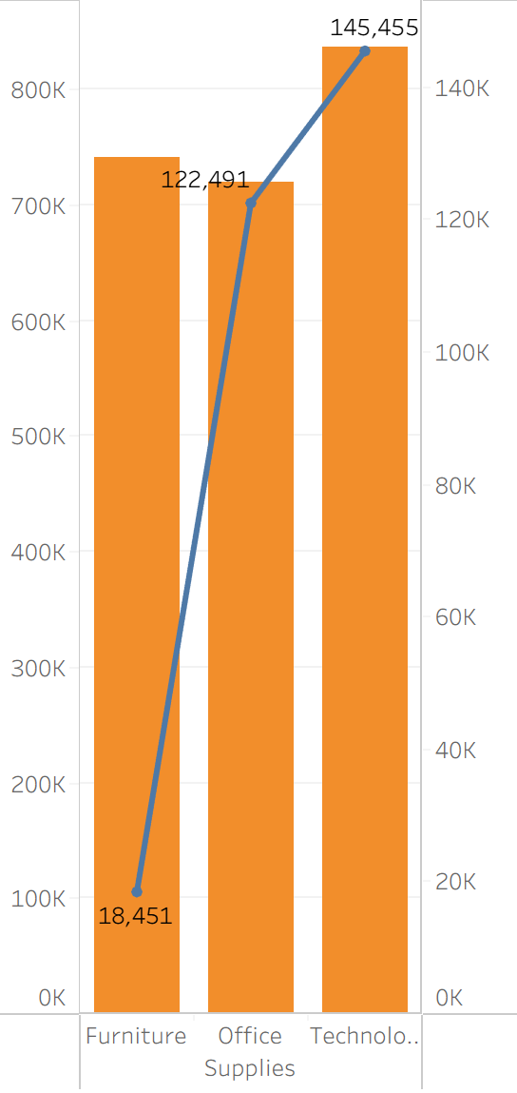
Category vs Sales & Profit
Problem Statement:
Determine if a few categories contribute
most to sales and profit.
Insights:
Technology & Office Supplies
dominate revenue.
Recommendations:
Focus on top categories for efficiency.

Slide 6
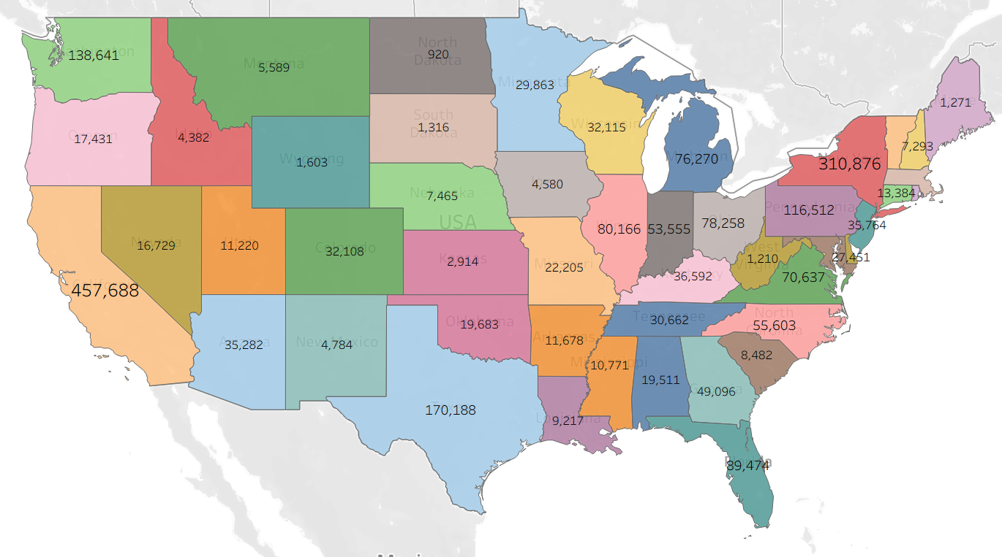
Sales by State
Problem Statement:
Find states with low profits despite high sales.
Insights:
California leads;
Texas lags.
Recommendations:
Review discounts in low-profit states.

Slide 7
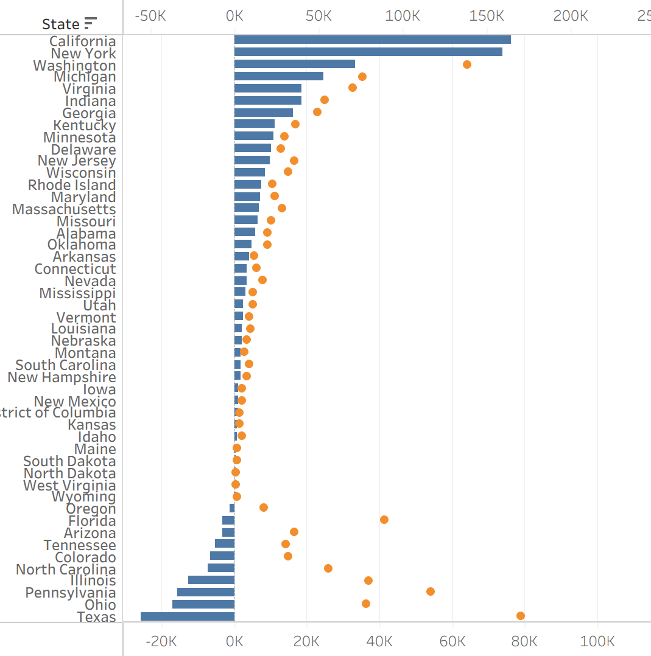
Profit by State
Problem Statement:
Find states with
low profits despite high sales.
Insights:
California leads;
Texas lags.
Recommendations:
Review discounts in
low-profit states.

Slide 8
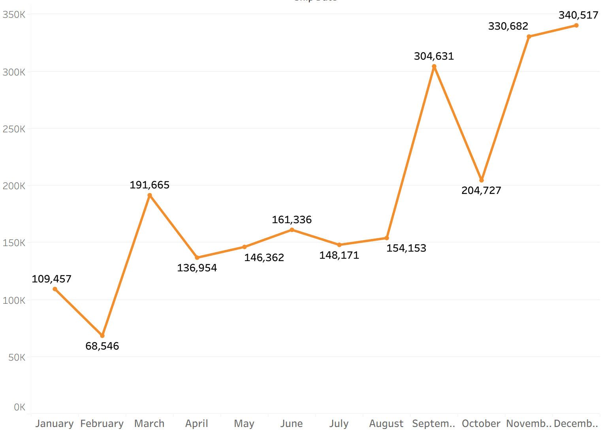
Monthly Sales Trend
Problem Statement:
Understand seasonality in sales.
Insights:
Sales peak in Nov-Dec.
Recommendations:
Prepare inventory before peak season.

Slide 9
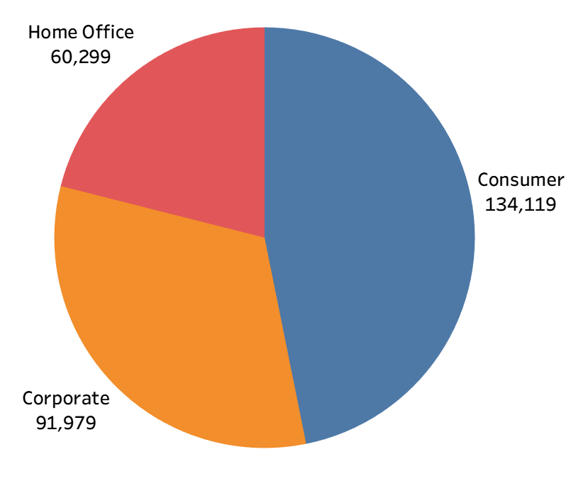
Customer Segment Performance
Problem Statement:
Identify most valuable customer segments.
Insights:
Consumers drive revenue.
Recommendations:
Retain Corporate; grow Consumer.

Slide 10
Thank You

